Slide 1
Woodland Park School District
Educator Effectiveness
Initial Training
August 2021

Slide 2

Training Outcomes
Understand the WPSD Evaluation System, including…
  State Guidelines
  General Components
  Professional Practice Rubric & Goal
  Measures of Learning “Looks” & Goal(s)
  Evaluation Cycles and Timelines
  Online Evaluation System

Slide 3
Key Colorado Legislation
What do we want students/educators/ schools/districts to know & be able to do? | How will we know if expectations are met? | How will we respond when help is needed?
Colorado Academic Standards CAP4K (SB 08-212) | Standards Assessments School Readiness Workforce Readiness | MTSS Targeted interventions IEPs
Educator Quality Standards Educator Effectiveness (SB 10-191) | Educator evaluations | Induction Mentoring Professional development plans Remediation plans
Performance Indicators Education Accountability Act (SB 09-163) | School and district performance frameworks | Unified planning Priority Turnaround
Students
Educators
Schools/ Districts

Slide 4
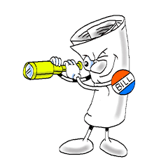
Senate Bill 10-191: The Big Picture
Statewide definition of effectiveness
Requires annual evaluations
Non-probationary status earned based upon 3 consecutive years of demonstrated effectiveness
Non-probationary status may be lost based upon 2 consecutive years of ratings below effective
Portability
Notes:
Knowing that educator evaluation has not been the most consistent or supportive, Senate Bill 191 was passed in 2010 to improve the way Colorado develops and supports great educators.
Lets review the main elements of SB 191:
Creates a statewide definition for both teacher and principal effectiveness
Increases the frequency of evaluations and ensures linkage of evaluation to targeted professional development
Makes tenure a meaningful decision, tied to performance expectations, rather than length of service
Eliminates the need for the district to make a high-stakes decision at the end of year 3
Provides novice teachers with more time to develop, if they are showing growth – more flexibility for the principal in making this decision
Links educator evaluation to success with students by including student growth measure
Aligns principal evaluation to the teacher evaluation
Placement – ensures mutual consent of the teacher and receiving school, with process in place for those teachers who do not secure positions to secure roles in the future, without stigma or limitations
Educators non-probationary status is now able to be transferred from district to district

Slide 5
WPSD Portability
Must complete “Request for Portability” Form
  Found on website (Human Resources Page)
  Must submit by September 30
Evidence of Effectiveness for the prior two (2) consecutive years, to include…
  Highly Effective or Effective ratings, and
  Meets Expectations or Higher Rating on an Individually Attributed Student Learning Assessment

Slide 6
General Evaluation Components
50% Measures of Learning
50% Professional Practice
Rubric
Professional Goal
Observations
Surveys
Artifacts
  School Performance Framework
  State/District Assessments
  Individually- Attributed Measures of Learning (MSL)

Slide 7
Professional Practice

Slide 8
Professional Practice Evaluation Rubric
Input – Observations, Perception Surveys & Artifacts
Rubrics – P1 Teachers, Teachers, SPED Teachers, Principals, Special Service Providers, Library Media Specialists, IRTs, Learning Coaches, & General Certified
Initial ratings shared by Mid-Year Conference; Final rating shared prior to the End-or-Year Conference
WPSD Web-Based Dashboard System

Slide 9
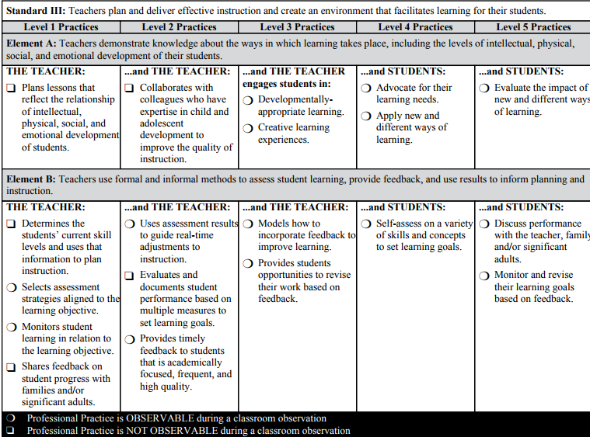
Standard
Proficient / Meets District Standard
Element
Practices
Professional Practice is Observable
Professional Practice is Not Observable
Notes:
This slide orients participants to the components of the rubric. It is important that we use a common language to refer to each of the components to avoid confusion.

Slide 10
Scoring the Rubric
Determining the professional practices rating is a 3-step process:
  Rating the Elements using the “Business” Rule
  Rating the Standards using an overall preponderance of Element scores
  Determining the Overall Professional Practices Rating using a weighted scale for each Standard roughly based on the number of Elements within the Standard

Slide 11
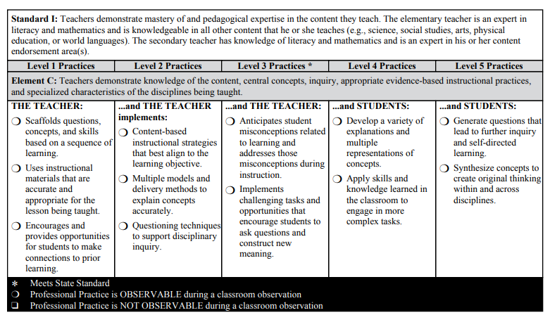
Reading the Rubric
Notes:
The rater starts with the first column of “Basic” to determine if any of these practices apply. Then the rater moves to the right for each column and checks all practices that apply.

Slide 12
“Business” Rule for Scoring
Look for the first unchecked professional practice.
Move one column back to identify the rating for the element.
Notes:
Examine rating level Basic to determine whether any of the professional practices describe the behaviors of the teacher. If the professional practice(s) described under rating level Basic are not marked, the rating level for the element under consideration Basic.
The rater then moves to rating levels Partially Proficient through Exemplary. For Standards I through IV, all professional practices that describes the teacher’s performance should be marked.
The rating for each element is the lowest rating for which all professional practices are marked. As illustrated, the teacher would be rated as Proficient for Standard 1, Element a.

Slide 13
Determining the Element Rating
Look for the first unchecked professional practice.
Move one column back to identify the rating for the element.
Notes:
The first unchecked professional practice is in Exemplary so the teacher would be rated as Accomplished for Std. 1, element b.

Slide 14
Determining the Element Rating
Look for the first unchecked professional practice.
Move one column back to identify the rating for the element.
Notes:
The teacher would be rated Partially Proficient for Std. 1, element c.

Slide 15
Rubric Rating Levels
Standard
Basic Practices | Partially Proficient Practices | Proficient Practices | Accomplished Practices | Exemplary Practices
Not Applicable to P1 Teachers
0
Educator’s performance is significantly below the state performance standard.
1
Educator’s performance is below the state performance standard.
2
Educator’s performance meets state performance standard.
3
Educator’s performance exceeds state standard.
4
Educator’s performance significantly exceeds state standard.
Notes:
Reminder of the values for each rating level which will be used to score the elements and standards.

Slide 16

Professional Practice Overall Rating
Based on Weighted Standard Scores
  Basic
  Partially Proficient
  Proficient
  Accomplished
  Exemplary

Slide 17

Professional Practice Goal
System Requirement
General Format
  Goal (What?)
  Sources (Why?)
  Plan (How?)
  Evaluation (Outcomes?)
Mid-Year and End-of-Year Reflections
Notes:
NOTE: Animated slide – click for steps 4 & 5 to disappear showing today’s focus on Steps 1, 2, & 3

Slide 18
Measures of Learning

Slide 19

State Requirements
Measure of Individually attributed student learning outcomes
Measure of Collectively attributed student learning outcomes
Statewide summative assessment (CMAS/PARRC/SAT) results and growth, when available
Multiple Measures

Slide 20

WPSD Measures of Learning
20% Collectively Attributed
80% Specific Measures of Learning (Individually Attributed)

Slide 21
School Performance Framework Scoring Matrix
Rating | % of Framework Points Earned
4 | At or above 80%
3 | At or above 64% - below 80%
2 | At or above 52% - below 64%
1 | Below 52%

Slide 22

Specific Measures of Learning
Looking for Evidence of Effectiveness
Stepping through 2 “Looks”

Slide 23

Fall Look
        Growth Modeling Measures
        STAR, MAP, DIBELS, & CMAS Gains
        2 Years of Data
  Weighted based on high growth, average growth, and low growth
  Computed within the Dashboard system
Proficient or Advanced Rating = Teacher’s Growth Score
Below Proficient
Not Applicable

Slide 24
Spring Look
        Measures of Student Learning
        Through the feedback and coaching process, teachers will use MSLs to gain valuable insight into student growth and inform instruction. It is understood that growth is more important than achievement.
        Staff utilize standards to…
          Establish learning outcomes,
          Monitor progress toward these outcomes, and
          Evaluate the degree to which students achieve these outcomes using relevant, meaningful measures
        Collaborative process between evaluatee and evaluator
        Final rating determined at the end of the evaluation year based on best “Look” from all data

Slide 25

5 Steps of the MSL Process
Step 1 : Identify key assessment/measure
Step 2 : Determine starting points & groupings
Step 3: Set an ambitious and achievable targets & scoring plan
Step 4: Track progress & refine instruction
Step 5: Review results and score in consultation with your evaluator
Notes:
NOTE: Animated slide – click for steps 4 & 5 to disappear showing today’s focus on Steps 1, 2, & 3

Slide 26

MSL Format
General Format (MSL Form) - website
Dashboard Caution
  Grouping is defined on initial set-up and cannot be changed once established
Further training, with department collaboration, coming early October
Support from Central Office Admin available in early October
Notes:
NOTE: Animated slide – click for steps 4 & 5 to disappear showing today’s focus on Steps 1, 2, & 3

Slide 27
WPSD Cycles & Timelines

Slide 28

WPSD Evaluation Process
Year-long
Clear timelines
Cyclical
WPSD Cycles 21-22

Slide 29
Online Dashboard System

Slide 30

Online Dashboard System
Dashboard Applications on the District Website Staff Links (pes.wpsdk12.org)
My Evaluation
Log-In: first initial last name & WPSD

Slide 31
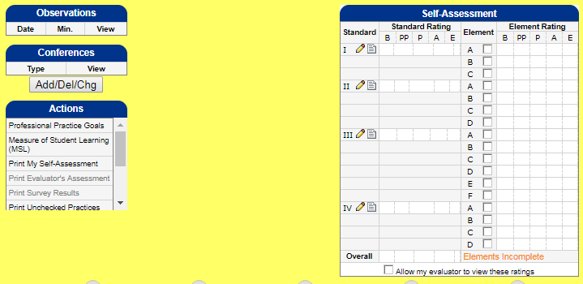
General Site Overview
https://pes.wpsdk12.org
Professional Goal
Professional Practice Rubric
MSL Goal
Share

Slide 32
Questions

